Slide 1
Rockbuster Data Findings
April Wiley

Slide 2
Agenda
Project Overview
Address the following business questions to prepare 2020 company strategy
What are the top ten countries Rockbuster customers are based in?
What are the top ten cities in the top ten countries?
Where are customers with a high lifetime value based?
What was the average rental rate for all videos?
What was the average rental duration for all videos?
Which movies contributed the most to revenue gains?
Which movies contributed the least to revenue gains?
Offer Recommendations

Slide 3
Overview
In the past, Rockbuster Stealth LLC had video rental stores all around the world.
To stay competitive, management at Rockbuster Stealth LLC decided to launch an online video rental service using its existing movie licenses.
To help with the launch, the Rockbuster Stealth Management Board has asked a series of important business questions to prepare the 2020 company strategy.
In the presentation, we will review the data findings discovered from the analysis of Rockbuster’s database.

Slide 4
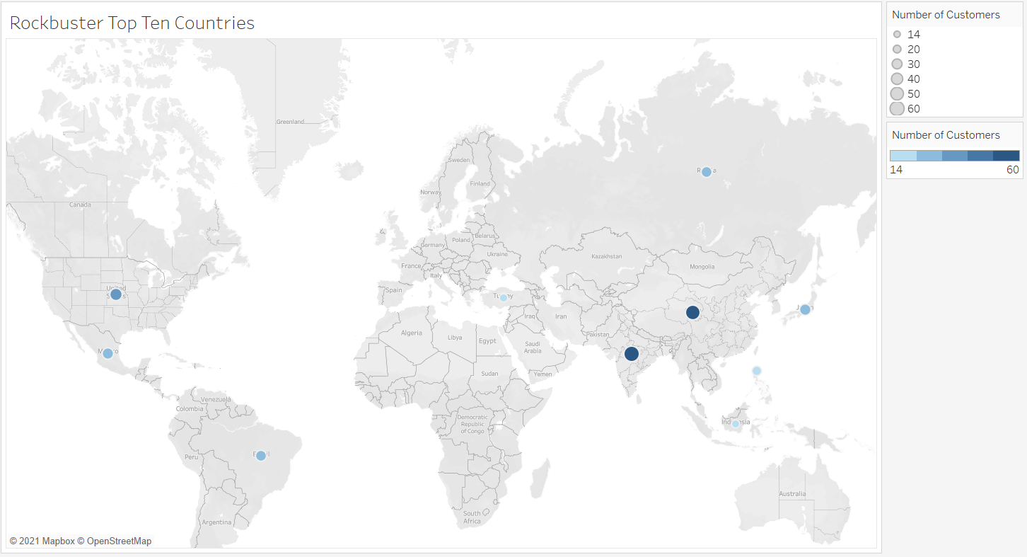
Rockbuster’s Data
Rockbuster has 599 customers in 109 countries.
The top ten countries and the number of customers in those countries can be seen in the visualization to the left.

Slide 5
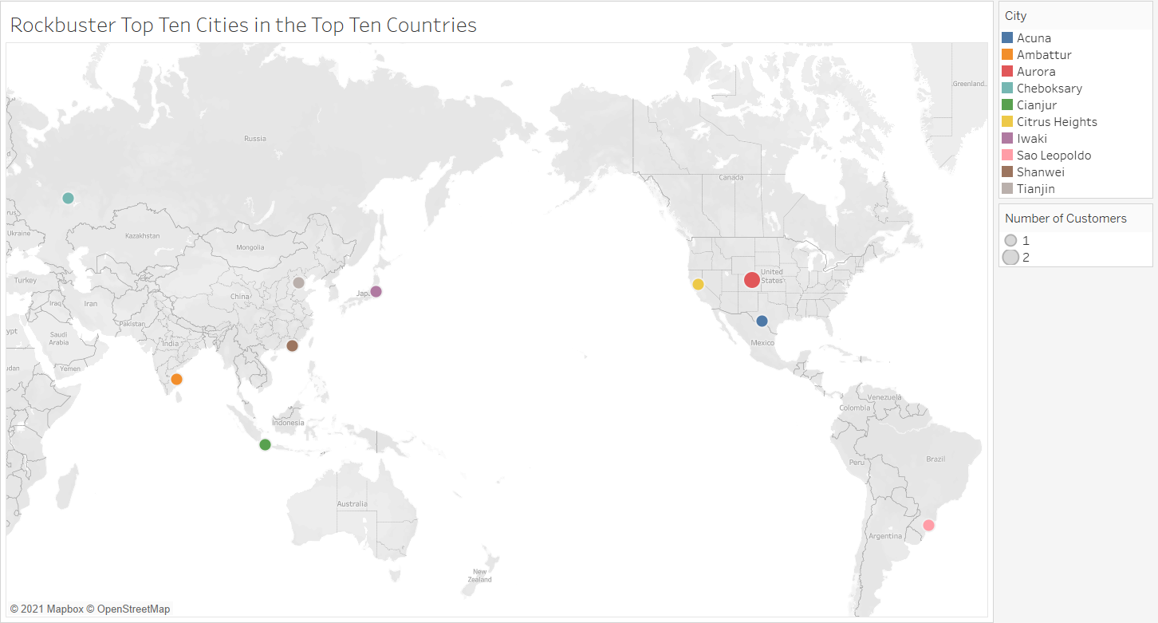
Rockbuster’s Data
The top ten cities within the top ten countries are shown in the visualization above.

Slide 6
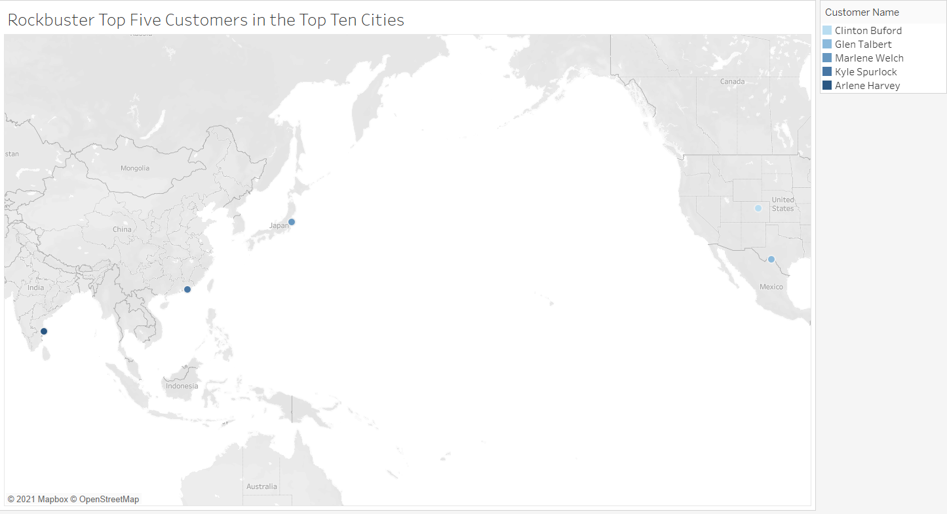
Rockbuster’s Data
The next visualization, seen to the right, shows where the top five customers within the top ten cities of the top ten countries are based.
They are the high lifetime value customers.

Slide 7
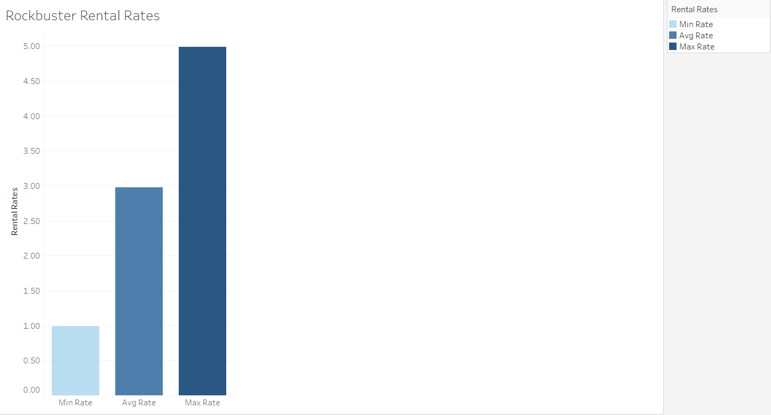
Rockbuster’s Data
Rockbuster has 1000 movie titles available to rent.
The minimum rental rate is $0.99.
The maximum rental rate is $4.99.
The average rental rate is $2.98.

Slide 8
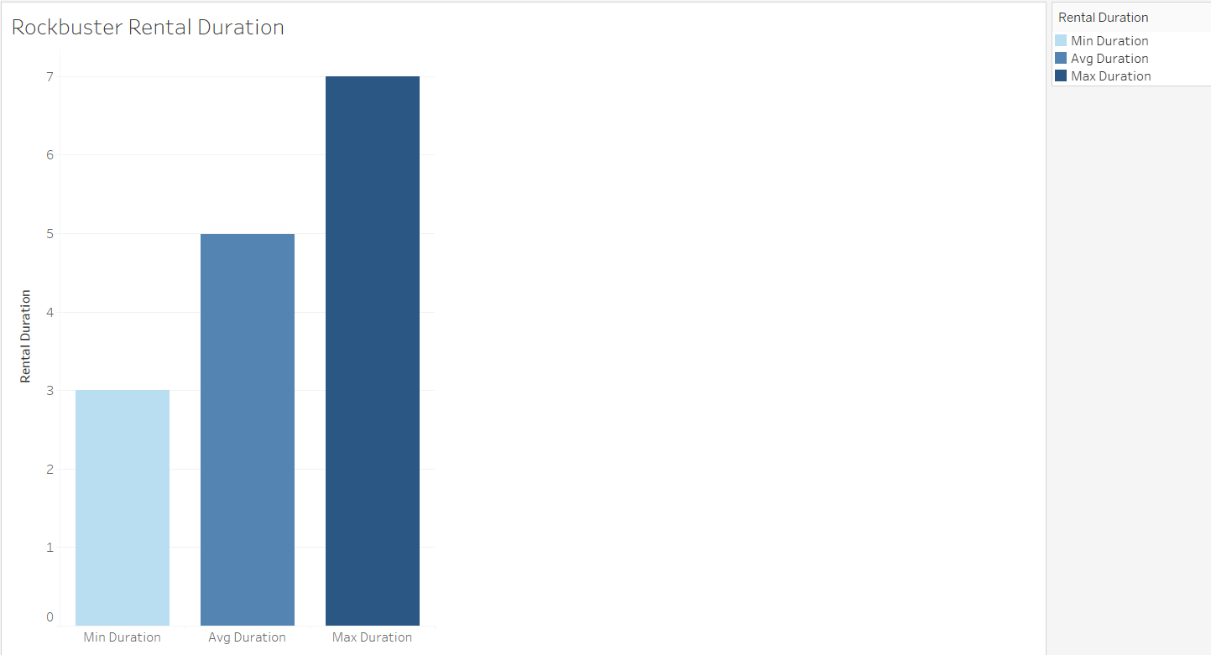
Rockbuster’s Data
The minimum rental duration is 3 days.
The maximum rental duration is 7 days.
The average rental duration is 5 days.

Slide 9
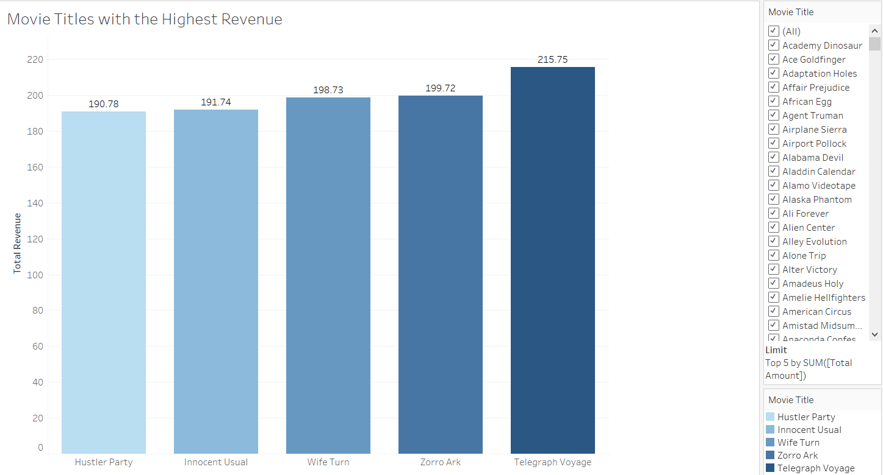
Rockbuster’s Data
The five movie titles with the highest revenue are shown in this visualization.

Slide 10
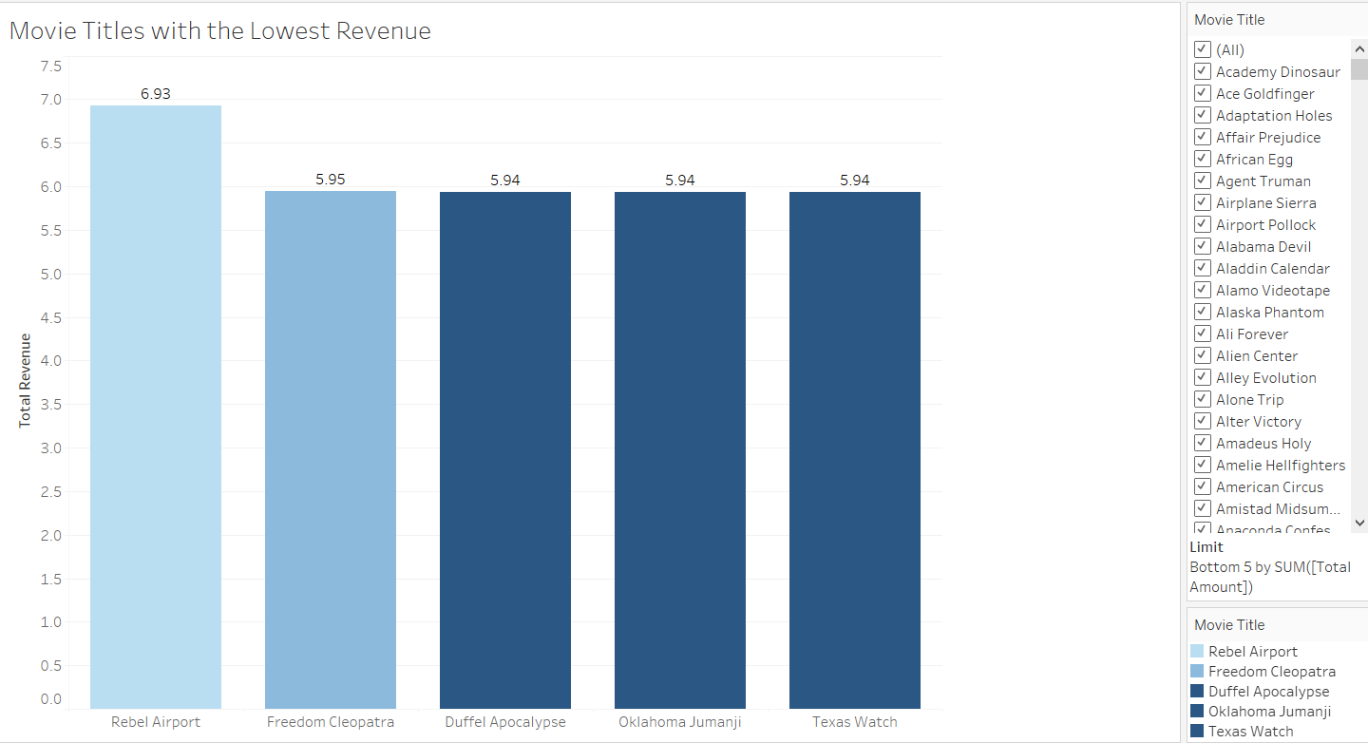
Rockbuster’s Data
The five movie titles with the lowest revenue are shown in this visualization.

Slide 11
Recommendations
Based on the data findings, the Rockbuster Stealth Management Board should consider the following for their corporate strategy:
Continue to allocate resources to the top ten countries and cities within those countries.
Consider developing a marketing campaign targeting additional cities within the top ten countries to drive additional revenue.
Offer loyalty-based rewards to the top five customers.
Market the loyalty-based rewards program to other customers to increase revenue.
Consider offering movie package deals for the top movie titles.
Consider removing less popular movie titles as they are adding very little revenue gain.

